Slide 1

Real Estate Management Dashboard
GROUP 24
Presented by: Omar Ashurbayov, Lalith Kothuru, Pranav Kuchibhotla, Austin Samuel

Slide 2
Overview
ERD
Challenges
DEMO
Agenda

Slide 3
Overview
Implemented RealEstate Database with mysql & python libraries
Worked on creating a schema for the Real Estate database setup
Implemented CRUD(Create, Read, Update, Delete) Operations
Collaborated using various technologies including VS code, PyCharm, SQL, GitHub, Google Docs, Zoom, and Discord to deliver a top-performing product.

Slide 4
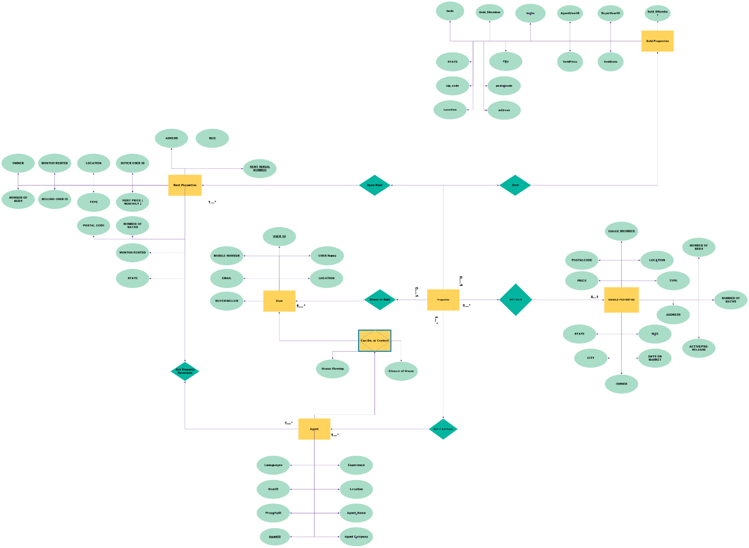

Slide 5
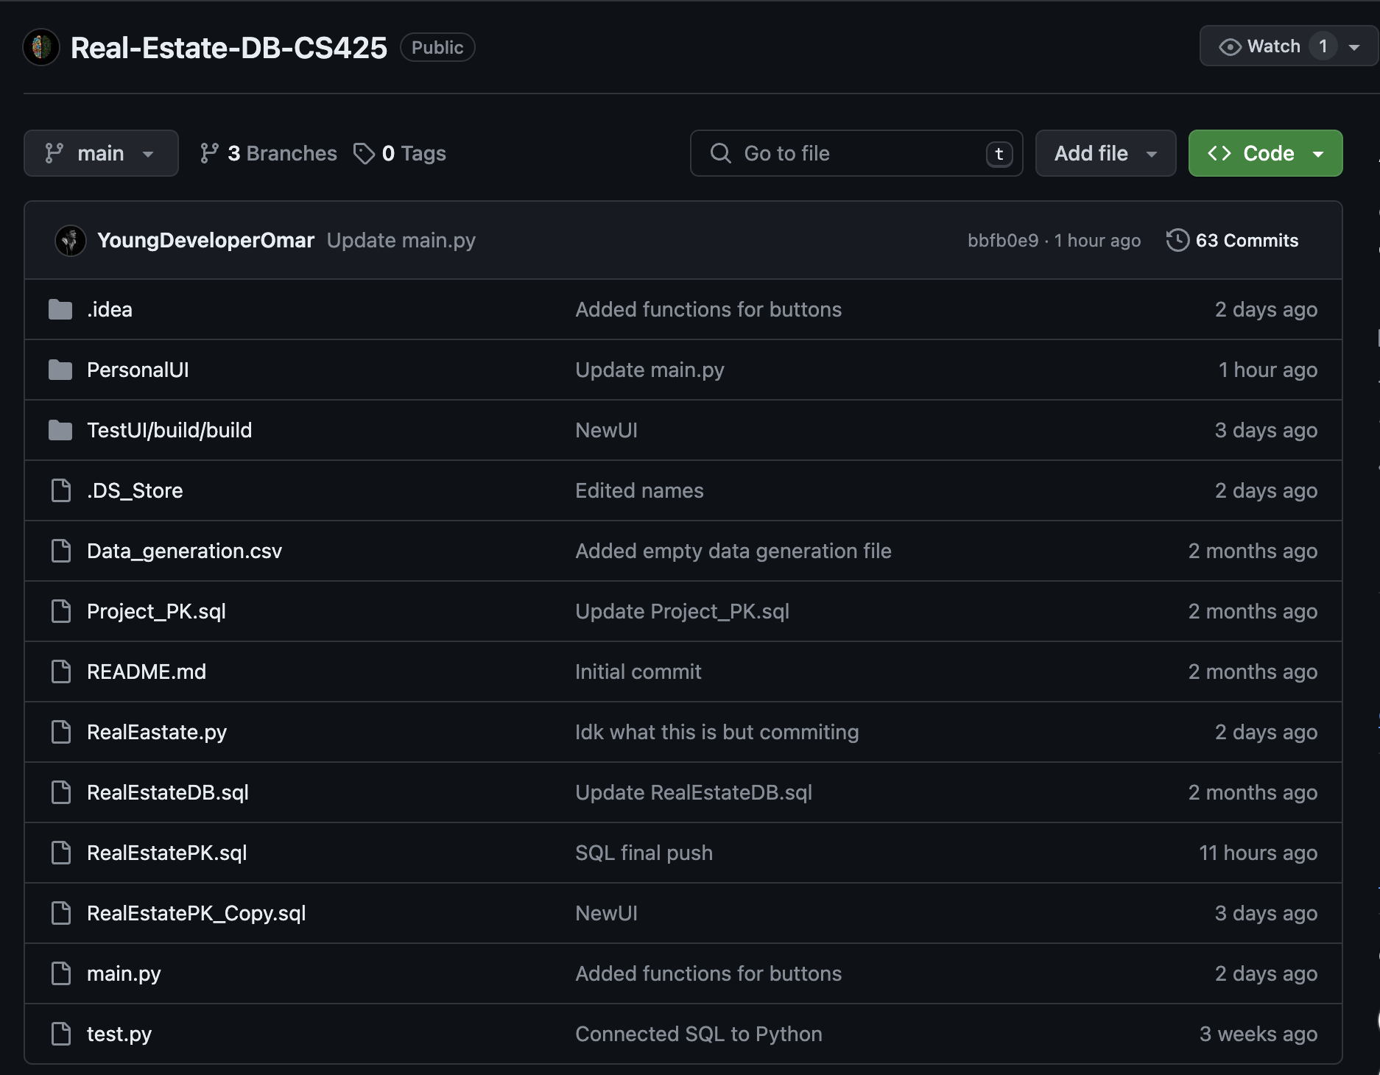
Challenges Overcome
Designing UI
Using new python libraries
Time management
Connecting SQL and Python
Team work
Using various applications

Slide 6
DEMO

Slide 7

Questions?

Slide 8





